Slide 1

Contemporary World
Dr. Muhammad Kashif

Slide 2
^{3rd} Terrorism Threatens World Security
What is terrorism
The historical background of terrorism
Terrorism during 21st Century
Case Studies of Terrorism

Slide 3
What is terrorism
The use of violence for the achievement of political ends is common to state and non-state groups.
criminal acts, including against civilians, committed with the intent to cause death or serious bodily injury, or taking of hostages, with the purpose to provoke a state of terror in the general public or in a group of persons or particular persons, intimidate a population or compel a government or an international organization to do or to abstain from doing any act.

Slide 4
Terrorism
Is an unlawful act of violence
Intimidates governments or societies
Goal is to achieve political, religious or ideological objectives
Arthur H. Garrison
Notes:
Terrorism is a political act designed by groups to have their message heard.
Arthur H. Garrison, How the World Changed: a History of the Development of Terrorism, presented at Delaware criminal Justice Council Annual Retreat, Oct 28-29, 2001
http://www.state.de.us/cjc/history.ppt

Slide 5
Terrorism and Freedom Fighting
Terrorism
Freedom Fighting

Slide 6
Early History of Terrorism
Terror has been used to achieve political ends and has a long history
As early as 66 – 72 A.D. Resistance to Roman occupation, terrorists killed Roman soldiers and destroyed Roman property.
Terror was used to resist occupation.
Notes:
Terror in many ways has been the weapon of groups who want their message heard, and want a political change, but do not feel that they have a way to be heard or have a voice. Terrorism is viewed as a means to be heard.
Arthur H. Garrison, How the World Changed: a History of the Development of Terrorism, presented at Delaware criminal Justice Council Annual Retreat, Oct 28-29, 2001
http://www.state.de.us/cjc/history.ppt

Slide 7
Hasan Bin Sabah
Born in Iran Qoum
Ismailis
داعی فدائی
حشاشین نامی تنظیم
شیخ الجبال
ہلاکو خان
Notes:
Terrorism has been viewed as honorable by the side who practices it. It is viewed as a crime against humanity by the victims of the countries attacked.
Arthur H. Garrison, How the World Changed: a History of the Development of Terrorism, presented at Delaware criminal Justice Council Annual Retreat, Oct 28-29, 2001
http://www.state.de.us/cjc/history.ppt

Slide 8
Modern History of Terrorism
The term “terrorism” was coined in the French Revolution’s Reign of Terror (1793 – 1794).
The Jacobins means the person against the government.
guillotine
Beheading
Bolsheviks
Ku Klux Klan
The line between terrorism and political violence is often unclear
Goal: of State terrorism was to eliminate opposition, consolidate power, e.g., the Vanished in Argentina
Notes:
.
Governments will sometimes try to suppress dissent. In the Military regime in Argentina in the 1960, young protestors sometimes even your age would sometimes “disappear” because of their views. The goal was to eliminate dissent, and maintain power.
Arthur H. Garrison, How the World Changed: a History of the Development of Terrorism, presented at Delaware criminal Justice Council Annual Retreat, Oct 28-29, 2001
http://www.state.de.us/cjc/history.ppt

Slide 9
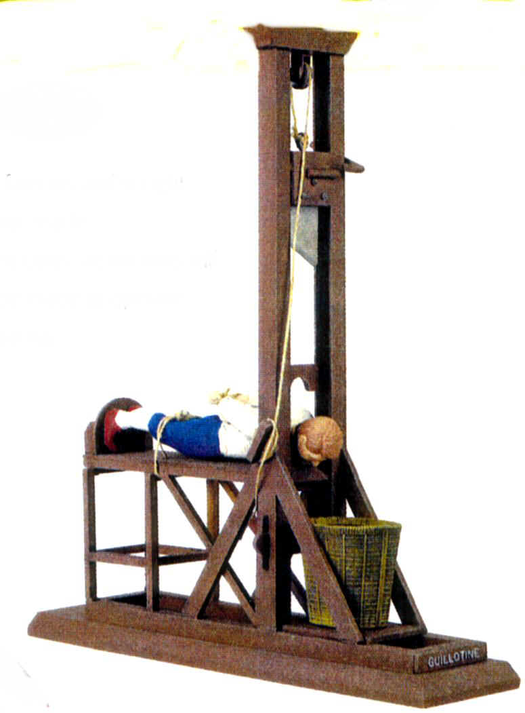
Guillotine
Notes:
.
Governments will sometimes try to suppress dissent. In the Military regime in Argentina in the 1960, young protestors sometimes even your age would sometimes “disappear” because of their views. The goal was to eliminate dissent, and maintain power.
Arthur H. Garrison, How the World Changed: a History of the Development of Terrorism, presented at Delaware criminal Justice Council Annual Retreat, Oct 28-29, 2001
http://www.state.de.us/cjc/history.ppt

Slide 10

Bolsheviks
Notes:
.
Governments will sometimes try to suppress dissent. In the Military regime in Argentina in the 1960, young protestors sometimes even your age would sometimes “disappear” because of their views. The goal was to eliminate dissent, and maintain power.
Arthur H. Garrison, How the World Changed: a History of the Development of Terrorism, presented at Delaware criminal Justice Council Annual Retreat, Oct 28-29, 2001
http://www.state.de.us/cjc/history.ppt

Slide 11

Ku Klux Klan
Notes:
.
Governments will sometimes try to suppress dissent. In the Military regime in Argentina in the 1960, young protestors sometimes even your age would sometimes “disappear” because of their views. The goal was to eliminate dissent, and maintain power.
Arthur H. Garrison, How the World Changed: a History of the Development of Terrorism, presented at Delaware criminal Justice Council Annual Retreat, Oct 28-29, 2001
http://www.state.de.us/cjc/history.ppt

Slide 12
The Postwar Years.
Nationalists attacked officials and others associated with the British ruling colonial government in Kenya, Cyprus, and South Yemen.
Algerian nationalists against the French colonial regime.

Slide 13
The Postwar Years.
Nationalists attacked officials and others associated with the British ruling colonial government in Kenya, Cyprus, and South Yemen.
Algerian nationalists against the French colonial regime.

Slide 14
Separatists .
In Spain, a Basque organization
Algerian nationalists against the French colonial regime.
Moro National Liberation Front began a campaign in 1960 to gain independence for Moros (Philippine Muslims) Its acts of terror left 50,000 dead and drove 20,000 Moro refugees to Malaysia before factionalism weakened it.

Slide 15
Governments also use terrorist acts .
In one famous incident, a Communist agent killed an anti-Communist Bulgarian dissident in a London subway by pricking his leg with a Poison-tipped umbrella.
Assassination of Cuban Premier Fidel Castro.
Latest case of Alexander Litvinenko

Slide 16
Guerrillas and Militants. .
violence committed by political groups outside
their own country.
state-sponsored terrorism
In Peru Shining Path militants planned a worldwide Communist revolution based on the principles of Mao Zedong

Slide 17
Terrorism in Industrialized Countries .
In Germany, a left-wing group known as the Red Army Faction carried out bombings, arson, kidnappings, and assassinations in their campaign against the (West) German government.
In Italy, numerous small revolutionary groups launched violent protests against the overnment. The best known of these, the Red Brigade, kidnapped and murdered Aldo Moro, a former prime minister, in 1978. In both Germany and Italy, concerted police action put an end to most radical terrorist activity
by 1980.

Slide 18
Terrorism in Industrialized Countries .
President Anwar Sadat, killed in 1981
India’s Prime Minister Indira Gandhi was slain by her Sikh bodyguards in 1984.
Rajiv Gandhi was killed in 1991, apparently the victim of Tamil separatists.

Slide 19
Hostages .
Islamic fundamentalists to power in Iran in 1979, Iranian militants seized the U.S. embassy and took some 50 Americans hostage. They demanded for reinstallation for Shah Pehlvi.
PLO Italian Cruise Ship.

Slide 20
Terrorist Attacks in the 1990s .
Hamas
PLO
Aum Shinrikyo and Tokyo Subway Serine Attack

Slide 21
Attacks Against the United States. .
New York attack
US embassies were attacked by alqaida
9 11 incident the day the world changed.
World has changed.

Slide 22
Current Terrorist Organizations .
داعش
بوکو حرام

